Slide 1
Pipelines
@LlewellynFalco

Slide 2
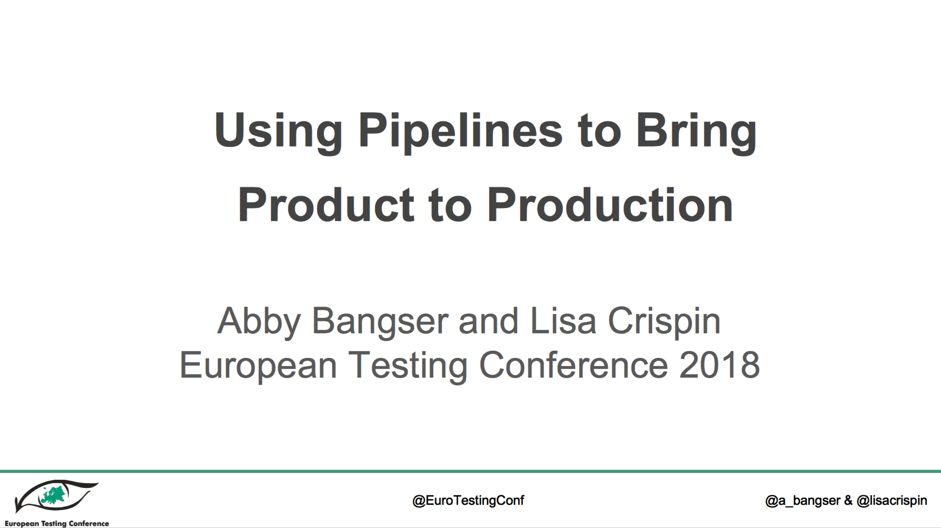
Blatantly stolen (with permission) from :

Slide 3
?
^{A commit happens}
^{Production Deploy}

Slide 4
^{Pre-Production Deploy}
(Can be used for User Acceptance Testing)
Notes:
17

Slide 5
Timing

Slide 6
1 < 2 Minutes 2 < 15 Minutes 3 < 1 hour 4 < 6 Hours 5 < ∞

Slide 7
Blocking?

Slide 8
Push / PULL

Slide 9
^{Automated Performance Testing}
Notes:
9

Slide 10
Timing
1 < 2 Minutes 2 < 15 Minutes 3 < 1 hour 4 < 6 Hours 5 < ∞

Slide 11
Blocking?

Slide 12
Push / PULL

Slide 13
Monitoring

Slide 14
^{Static Analysis Validation}
Notes:
4

Slide 15
Parallel?

Slide 16
Timing Blocking? Push / Pull Monitoring
1 < 2 Minutes 2 < 15 Minutes 3 < 1 hour 4 < 6 Hours 5 < ∞

Slide 17
^{User Acceptance Testing}
Notes:
114

Slide 18
Parallel? Timing Blocking? Push / Pull Monitoring
1 < 2 Minutes 2 < 15 Minutes 3 < 1 hour 4 < 6 Hours 5 < ∞

Slide 19
^{Exploratory Testing}
Notes:
12

Slide 20
Parallel? Timing Blocking? Push / Pull Monitoring
1 < 2 Minutes 2 < 15 Minutes 3 < 1 hour 4 < 6 Hours 5 < ∞

Slide 21
^{Unit Testing}
Notes:
10

Slide 22
Parallel? Timing Blocking? Push / Pull Monitoring
1 < 2 Minutes 2 < 15 Minutes 3 < 1 hour 4 < 6 Hours 5 < ∞

Slide 23
^{Automated Smoke Testing}
Notes:
5

Slide 24
Parallel? Timing Blocking? Push / Pull Monitoring
1 < 2 Minutes 2 < 15 Minutes 3 < 1 hour 4 < 6 Hours 5 < ∞

Slide 25
^{Security Environment Deploy}
Notes:
8

Slide 26
Parallel? Timing Blocking? Push / Pull Monitoring
1 < 2 Minutes 2 < 15 Minutes 3 < 1 hour 4 < 6 Hours 5 < ∞

Slide 27
^{Test Environment Deploy}
Notes:
16

Slide 28
Parallel? Timing Blocking? Push / Pull Monitoring
1 < 2 Minutes 2 < 15 Minutes 3 < 1 hour 4 < 6 Hours 5 < ∞

Slide 29
^{Performance Environment Deploy}
Notes:
13

Slide 30
Parallel? Timing Blocking? Push / Pull Monitoring
1 < 2 Minutes 2 < 15 Minutes 3 < 1 hour 4 < 6 Hours 5 < ∞

Slide 31
^{Code is merged}
^{into trunk}
Notes:
15

Slide 32
Parallel? Timing Blocking? Push / Pull Monitoring
1 < 2 Minutes 2 < 15 Minutes 3 < 1 hour 4 < 6 Hours 5 < ∞

Slide 33
^{Security}
^{Penetration}
^{Testing}
Notes:
3

Slide 34
Parallel? Timing Blocking? Push / Pull Monitoring
1 < 2 Minutes 2 < 15 Minutes 3 < 1 hour 4 < 6 Hours 5 < ∞

Slide 35
Automated User Interface Testing
Notes:
11

Slide 36
Parallel? Timing Blocking? Push / Pull Monitoring
1 < 2 Minutes 2 < 15 Minutes 3 < 1 hour 4 < 6 Hours 5 < ∞

Slide 37
Automated Integration and API Testing
Notes:
11

Slide 38
Parallel? Timing Blocking? Push / Pull Monitoring
1 < 2 Minutes 2 < 15 Minutes 3 < 1 hour 4 < 6 Hours 5 < ∞

Slide 39
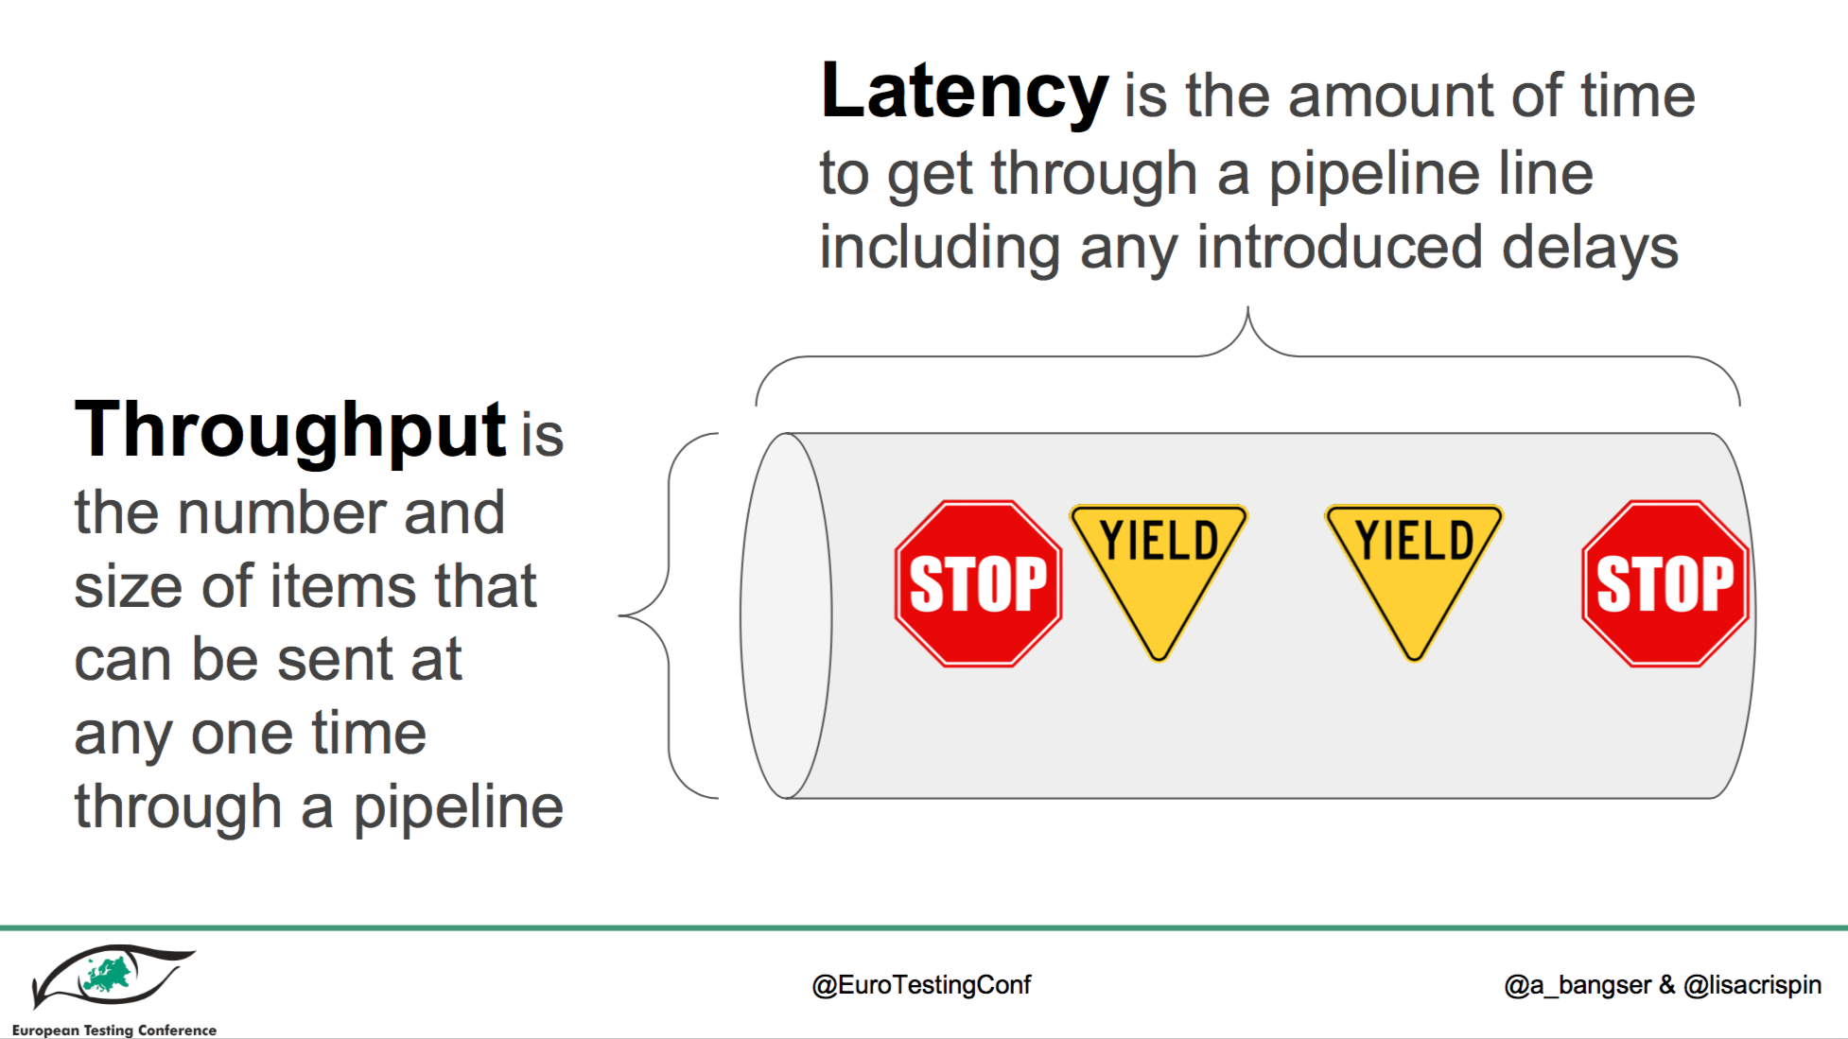

Slide 40
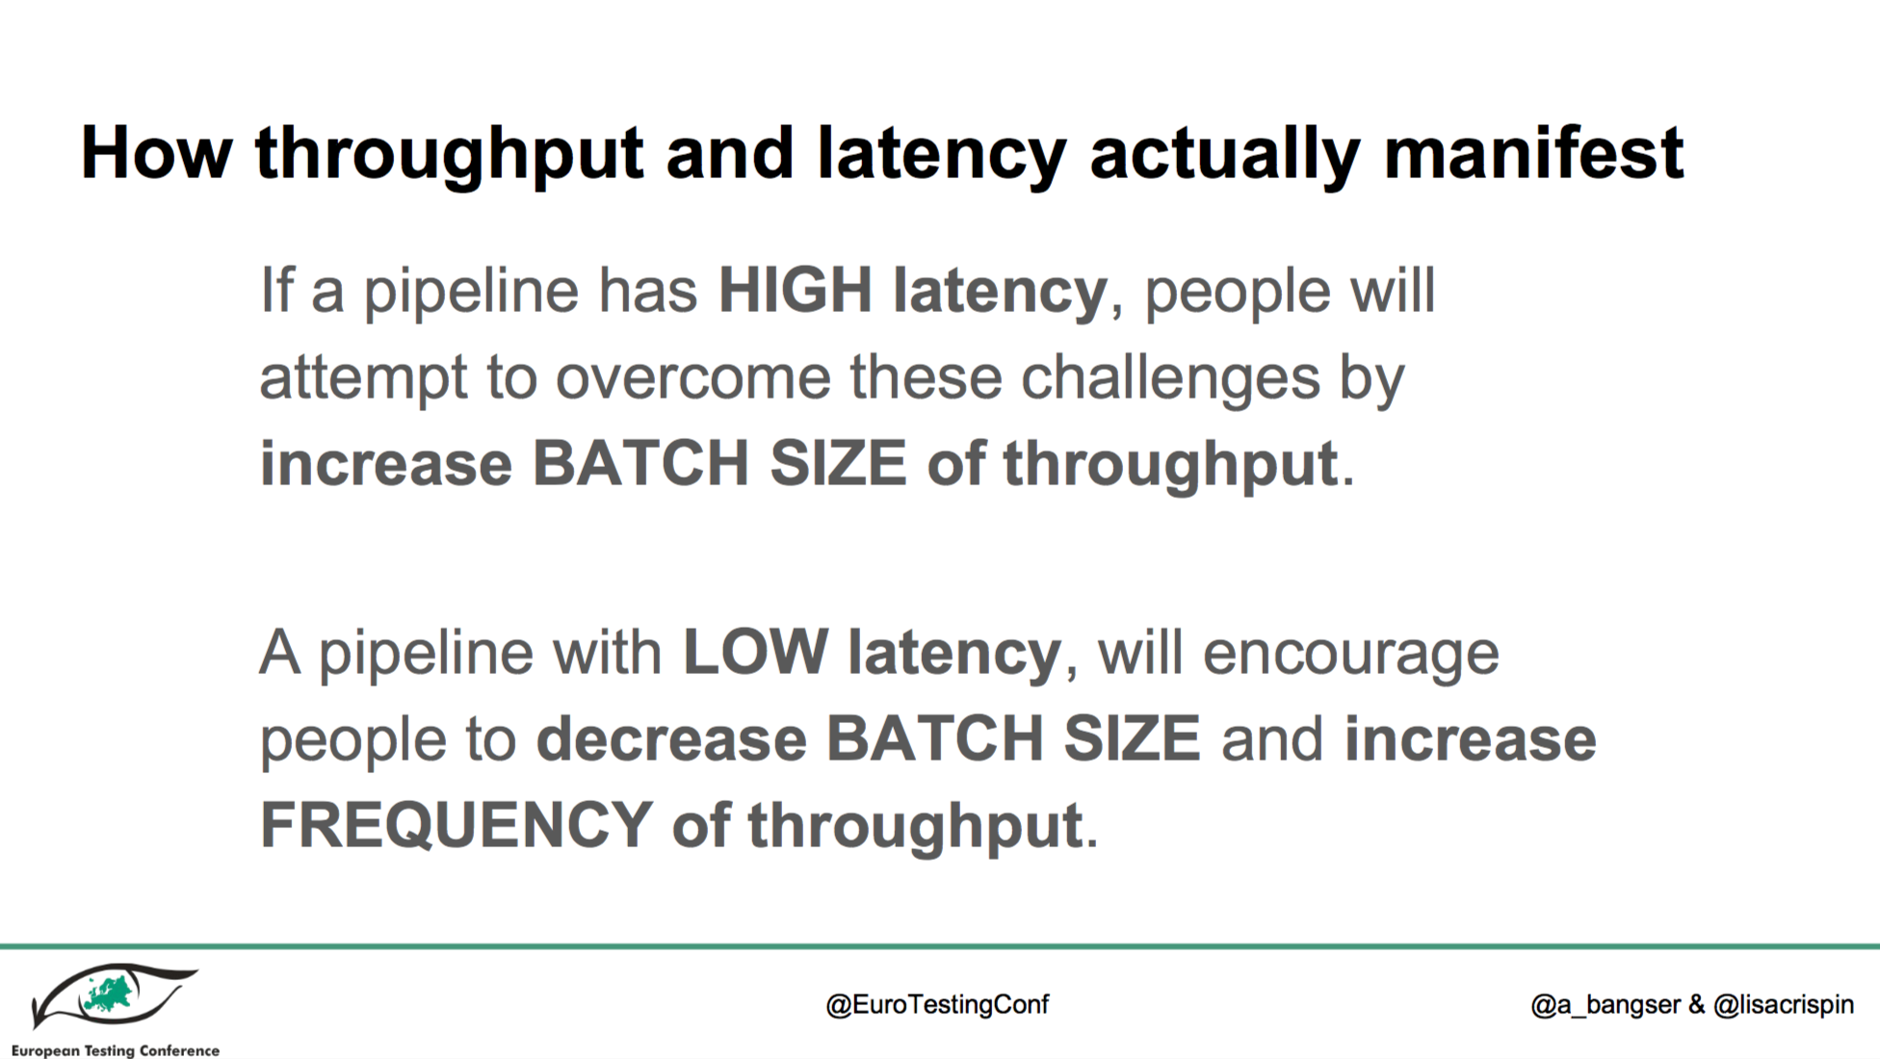

Slide 41
About the Authors

Slide 42


Lisa is the co-author many
fabulous books and courses on
testing.
She was voted “Most Influential
Agile Testing Professional Person”
in 2012.
Lisa enjoys helping people find ways to build more quality into their software products, as well as hands-on testing.
More at:
www.lisacrispin.com
www.agiletester.ca
@LisaCrispin
Use code AGILETESTING at
informit.com/agile for 35%-50% off

Slide 43
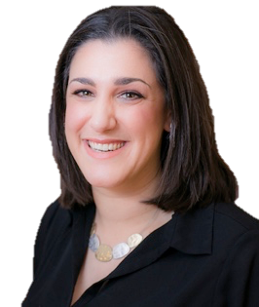
Abby is currently working at ThoughtWorks for the last 6 year.
She believes that while the technical requirements of each domain and tech stack can be challenging, team practices and team ownership have a much deeper impact on the end deliverable.
She blogs at testerbychoice.wordpress.com
- Abby Bangser @a_bangser

Slide 44

Thank YOU (please connect via LinkedIn and Twitter)
@LlewellynFalco
youtube.com/isidoreus
LlewellynFalco.Blogspot.com approvaltests.com

